Slide 1



Nielsen tech design SAP BTP AI use cases
SAP Internal Only
SAP BTP AI Team – Andrii Rzhaksynskyi, Joel Rodriguez
Aug 2025
INTERNAL – SAP and Partners Only

Slide 2

Nielsen POC UI & resources
Git: https://github.tools.sap/sap-btp-ai-services-coe/nielsen-streamlit/tree/main
App: https://nielsen-agent.cfapps.eu10.hana.ondemand.com/
Business Scenario Design Document Link
Video – Nielsen Intelligent Purchasing Agent.mp4
Decision tree from Customer SAP AI P2P Solution Decision Tree.xlsx

Slide 3
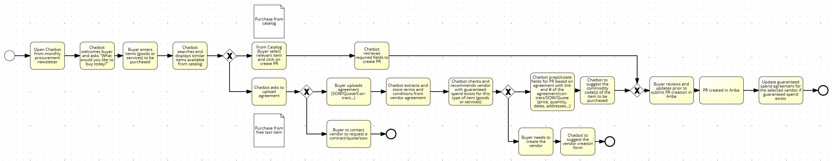
Nielsen process diagram - Signavio
https://editor.signavio.com/p/editor?id=437cf193af1c4457b2d77b4607558287

Slide 4
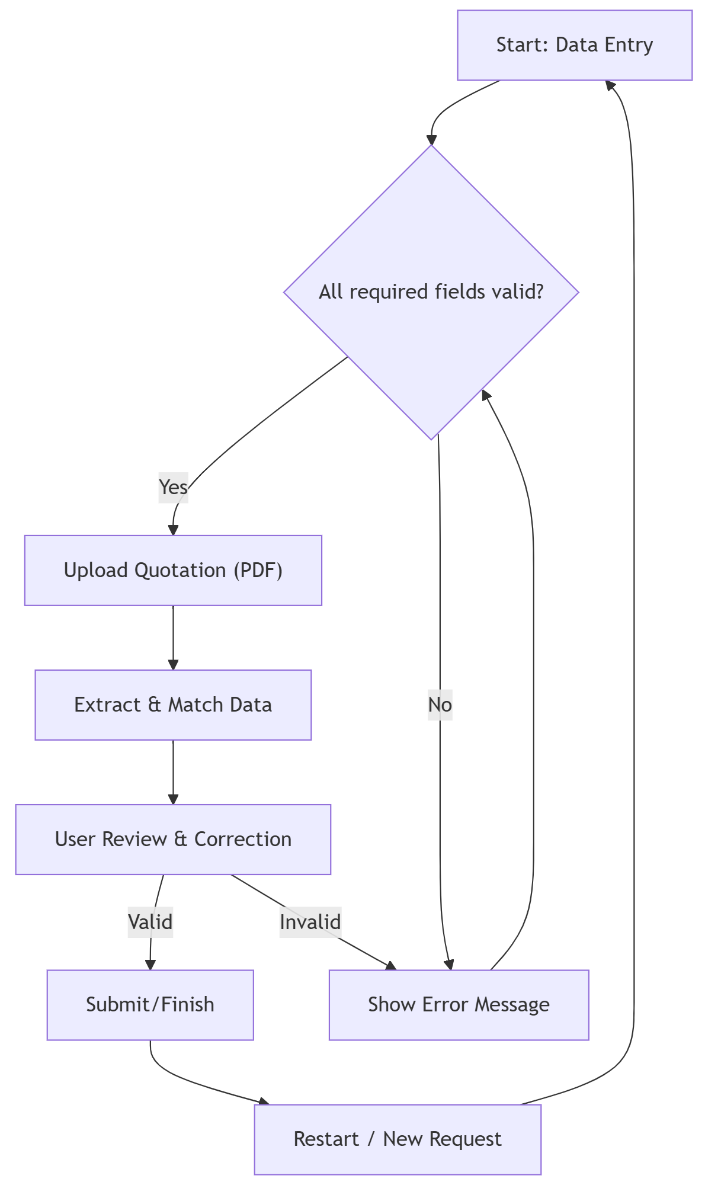
User Journey & Step Sequence
Step | Description
1. Data Entry | User fills in material/vendor info. Checks against master data. Required fields must be completed.
2. Validation | At every stage, the app validates that required fields are filled and values are plausible.
3. Document Upload | Users can upload quotation (PDF). The app auto-extracts and matches data fields.
4. Confirmation | The user reviews and can edit extracted data. Final validation before submission.
5. Completion | The system provides feedback or success messages. Users may restart the process as needed.

Slide 5
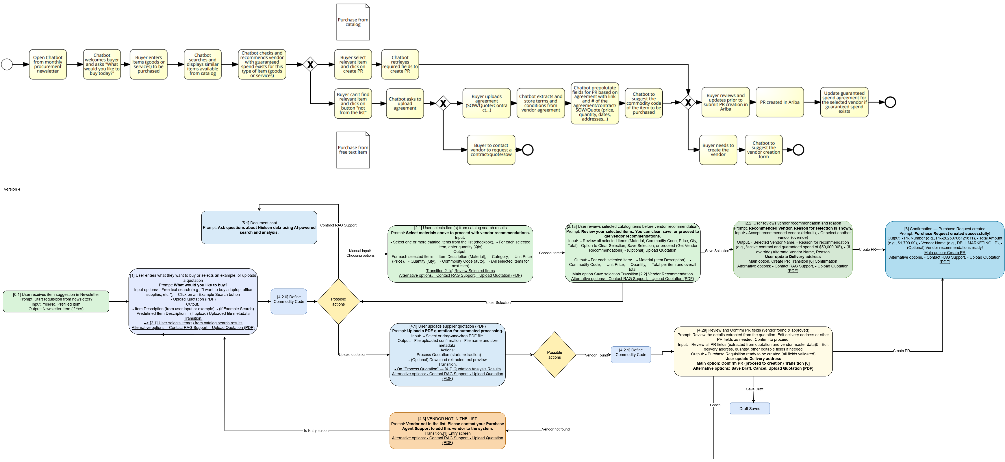
Nielsen process diagram – draw.io
https://github.tools.sap/sap-btp-ai-services-coe/nielsen-streamlit/blob/main/Nielsen%20202507-Nielsen%20Process%20Flow.drawio.png

Slide 6
File Structure Overview
File/Module | Role / Main Content
app.py | Main Streamlit logic and workflow
materials.py | Material search and LLM integration
quotation.py | Quotation extraction/analysis, PR creation
vendor.py | Vendor lookup and recommendation logic
text.py | Text-based commodity code suggestion
utils.py | Shared utilities (e.g., safe_dataframe)
*.csv files | Reference/master data

Slide 7
Python Functions & Responsibilities
Function Name | Purpose/Responsibility | File
safe_dataframe | Display DataFrame compatibly with any Streamlit version | app.py, utils.py, quotation.py
main | Main entry point for app logic | app.py
get_embedding, ask_llm | Integrate with LLMs/SAP AI for materials/text search | materials.py, text.py
search_materials_with_llm | Core LLM-based material search | materials.py
extract_text_from_pdf | Extract and parse text from uploaded PDF | quotation.py
analyze_quotation_with_llm | Analyze quotations and extract commodity codes | quotation.py
simulate_pr_creation | Simulate creation of a purchase request | quotation.py
show_non_catalog_purchase | Non-catalog PR interface logic | text.py
find_best_vendor | Identify the best vendor for a given item | vendor.py
format_currency, format_number | Format numbers for display | quotation.py, vendor.py
...and more

Slide 8
Streamlit logic – code pattern
# Example pseudo-logic for a Streamlit screen
if st.session_state.get("step") == "entry":
# Show form
material = st.text_input("Material")
vendor = st.selectbox("Vendor", vendor_list)
if st.button("Next") and material and vendor:
st.session_state["step"] = "upload"
st.rerun()
elif st.session_state.get("step") == "upload":
# Show upload interface
uploaded = st.file_uploader("Upload quotation")
if uploaded:
# Process file and extract data
extract_data(uploaded)
st.session_state["step"] = "review"
st.rerun()
elif st.session_state.get("step") == "review":
# Show extracted data for confirmation
st.write(st.session_state["extracted_data"])
if st.button("Submit"):
# Final action
save_pr()
st.success("Done!")

Slide 9
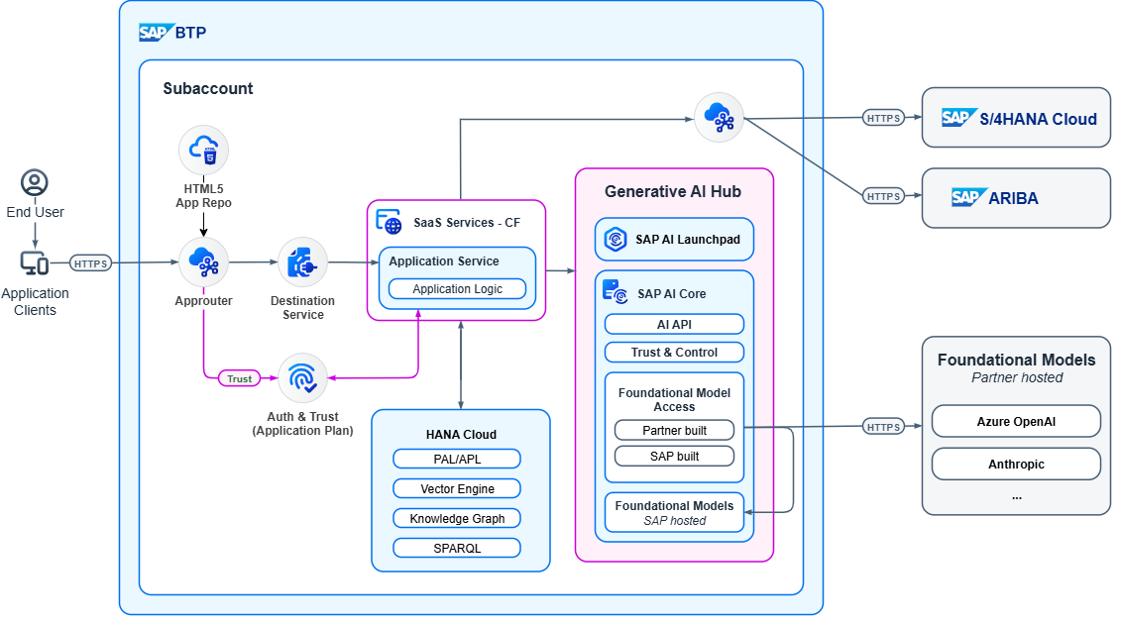
SAP BTP architecture to be

Slide 10
Thank you!

